Slide 1
Image Processing in surveillance systems
Belorussian State University of Informatics and Radioelecronix
Aspirant: Siarhei Kuchuk Alexandrovich
Chief: Sadykhov Rauf Hosrovovich

Slide 2
Video surveillance systems applicable areas
casinos, supermarkets, bars, streets,
office buildings, trade centers, oil stations, pipeline monitoring,
hospitals, universities, schools,
factories: transformer substations, objects of fuel, chemical, energy sector, storage facilities of dangerous for people and ecology substances,
Parkings (safety, car theft and damage registration),
dwelling areas,
monuments, stadiums.

Slide 3
Problems (1/2)
costs of keeping lots of security personnel on medium and large objects is high,
property is unprotected from theft, fire, improper usage,
provements of crime, (un)proper service (police, ambulance, taxi car built-in cameras),
stolen cars search,
roads are not safe; violatators of law must pay penalties,
traffic optimization (light signals correction on crossroads),
people are not safe in transport, schools from different threats (including terrorist threats)

Slide 4
Problems (2/2)
service of transformation subsystems,
service of buildings, including security, search of left things near stairs and in basements, fire control, lifts control, equipment state, energy saving,
control access to areas and reduce time on identification,
control resources, stores, production, climate, work progress,
getting safest way during evacuation,
business: videoconferences, merchandising,
interactive television services, lecture records, watching for ill people and children.

Slide 5
Designed system purpose
Detect movements in sterile zones and left things,
Detect fight,
Detect fallen human.

Slide 6
Environments
Production
Development

Slide 7
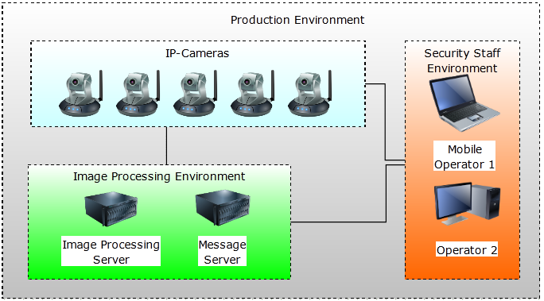
Production Environment

Slide 8
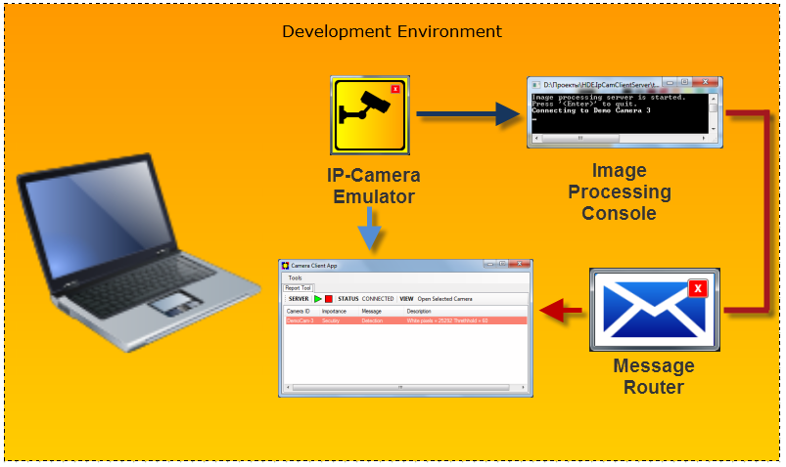
Development Environment

Slide 9
Software Components
Client Application
Image Processing Console
Message Router
IP-Camera (or Emulator)

Slide 10
Client Application
Client application is a tool for security staff which receives results of image processing work and can access any MJPEG IP-Camera.
It has Report and Camera Viewer Tools

Slide 11
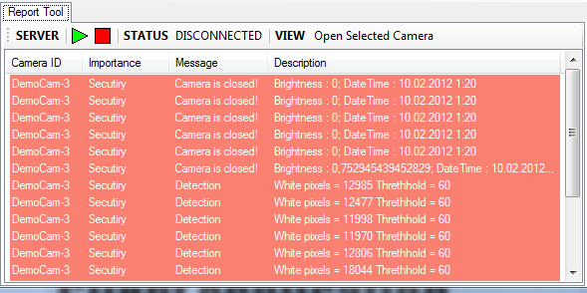
Report Tool of Client (1 / 2)

Slide 12
Report Tool of Client (2 / 2)
Report Tool connects to Message Router and receives all notifications that are sent by image processing consoles.
Security Staff sees real-time notifications and may access camera with double click on event.

Slide 13
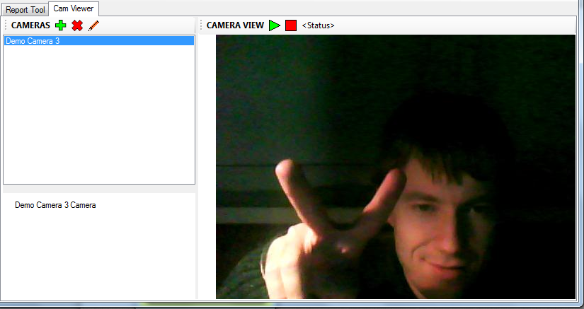
Camera Viewer Tool of Client (1 / 2)

Slide 14
Camera Viewer Tool of Client (2 / 2)
In Camera Viewer Tool user can add, edit, delete and connect to any MJPEG IP-Cameras.

Slide 15
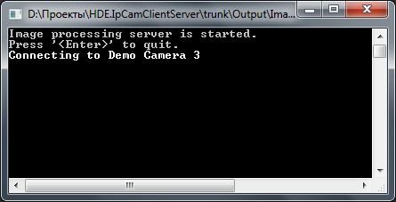
Image Processing Console
Image processing console gets video from IP-Camera or its emulator.
Processing results are sent to Message Router. Movement in sterile area, camera closure detection are implemented.

Slide 16

Message Router
Message Router receives results of image processing from image processing consoles and resends them to all subscribers (client applications).
Rhino Queues are used.

Slide 17
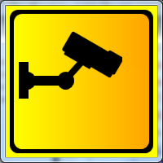
IP-Camera (or Emulator)
Emulator imitates MJPEG IP-Camera and can transfer with desired frequency different kinds of input data:
Web-camera video stream,
AVI, WMV files,
folder with images.

Slide 18
End
Questions?

